Slide 1
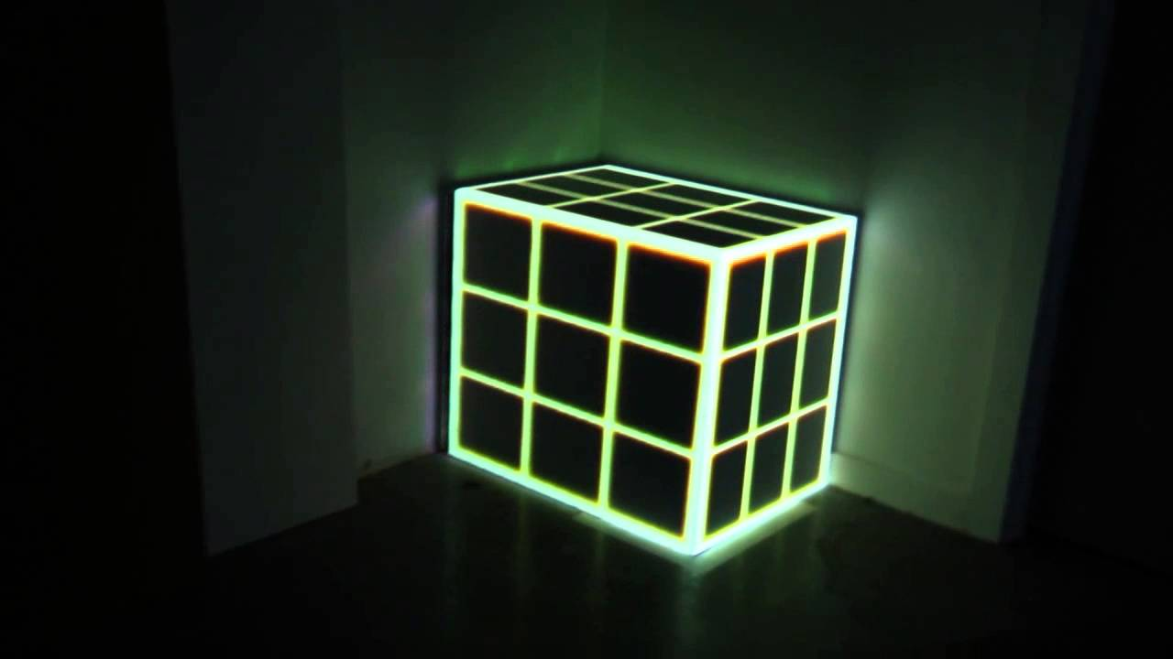
Moment Maps of Galaxy Datacubes from SIGAME
https://i.ytimg.com/vi/XZj8LqHNJvE/maxresdefault.jpg

Slide 2
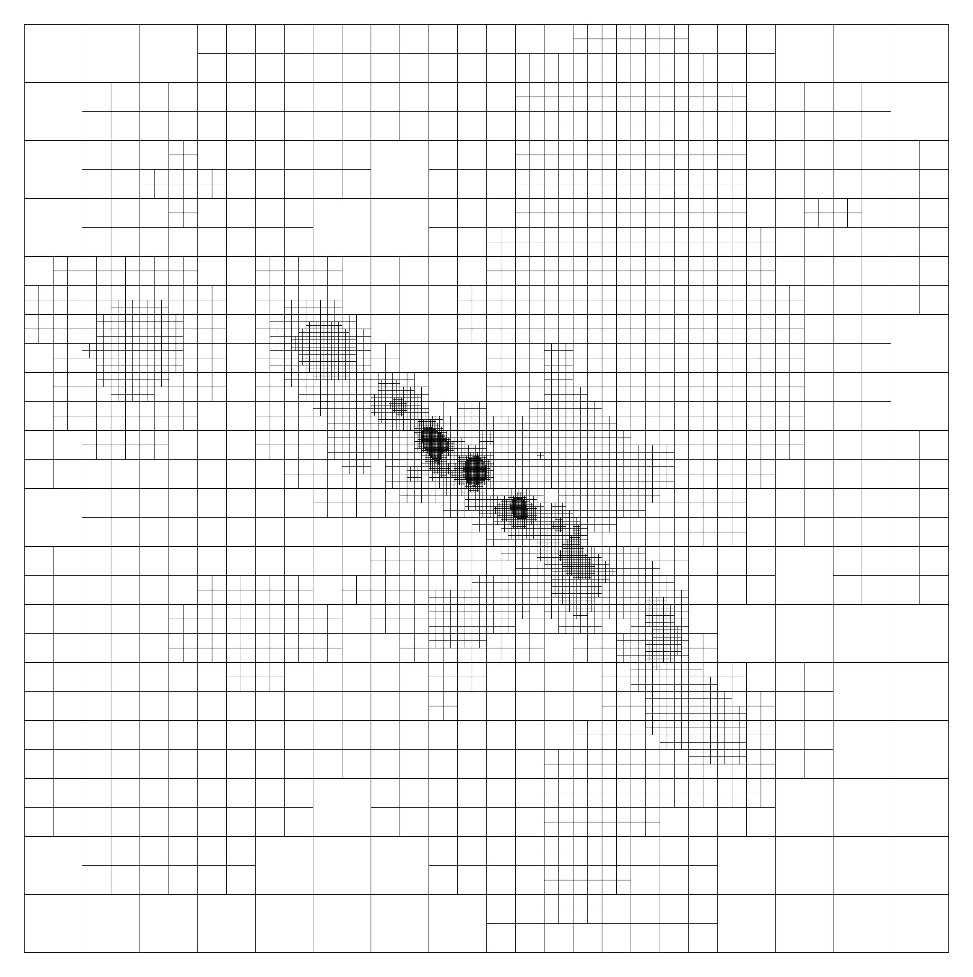
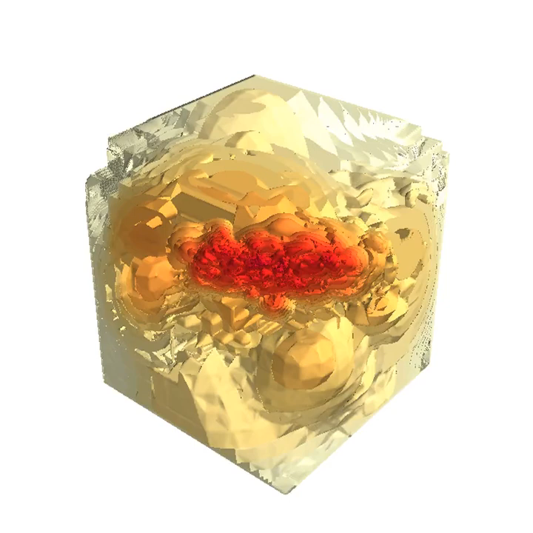
Data cube:
Credits: Karen Olsen

Slide 3
Algorithm:
Apply KD-Tree to centre-coordinates of the pixel to find any cells within the distance R.
Loop through these nearest neighbours of the given pixel to check overlapping.
If it overlaps, then find the overlapping cross-section.
Multiplying the cross-section area with the surface luminosity of the cell.
Adding up all that luminosity within the column covered by that pixel along the line of sight.
Run two while loops to go through every pixel in 2D.

Slide 4

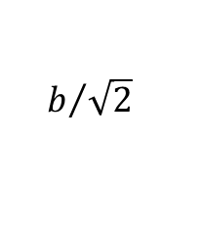
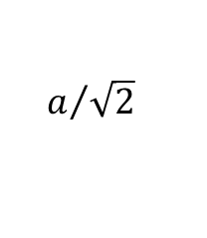
Scipy’s spatial.KDTree class: https://docs.scipy.org/doc/scipy/reference/generated/scipy.spatial.cKDTree.html
query_ball_point() method
Identifies all the points within a particular radius from the particular point
Set the radius to be the maximum distance between centre of any touching cell and centre of the pixel
Radius (R) = $a/{\sqrt{2}}$ + $b/{\sqrt{2}}$
b
$$b/{\sqrt{2}}$$
$$a/{\sqrt{2}}$$
Biggest cell
a
Pixel

Slide 5

Overlapping:
Loop through each nearest neighbour cell to check overlapping
Cell and pixel overlaps if and only if:
max(starting edges) – min(ending edges) < 0
$$start2−end1<0$$
start2
end2
start1
end1
+ axis

Slide 6

Cross-section Area and Adding up Luminosity:
Then, we find cross-section area of the overlapping cell and pixel.
We multiply this cross-section area with the surface luminosity of the cell.
We add up all the luminosity in that particular pixel.
We find surface luminosity of every pixel using while loops.
$$a=end1−start2=\min\left(ends\right)−\max\left(starts\right)$$
a*b
b
a
start2
end2
start1
end1
+ axis

Slide 7
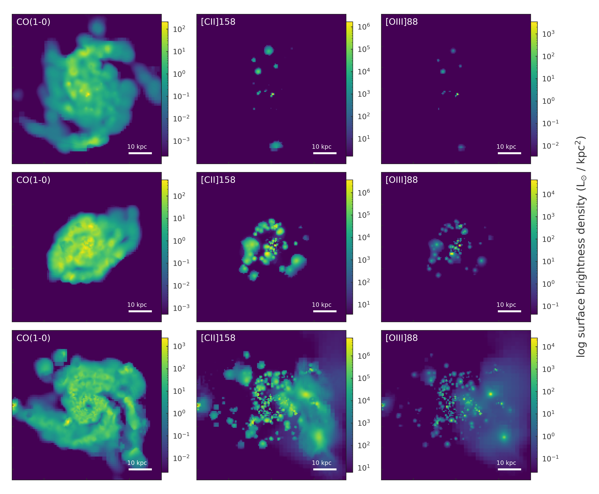
Results:

Slide 8
Future Endeavors:
Creating line ratio maps from the moment0 maps and analysing them.
Correlating moment0 maps of line emissions to various properties of ISM.
Creating radial maps.
Implementation of higher order moment maps.

Slide 9
Thank You - Jay Motka Email: jaymotka@email.arizona.edu
https://i.ytimg.com/vi/XZj8LqHNJvE/maxresdefault.jpg

